Slide 1
Components Of .NET Framework
Presented By
SAI KIRAN BEKKANTI

Slide 2
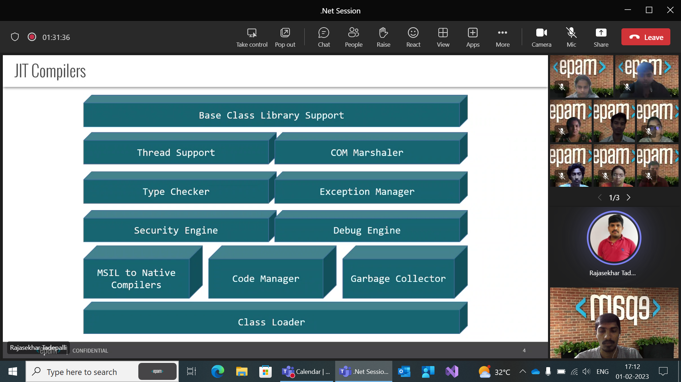

Slide 3
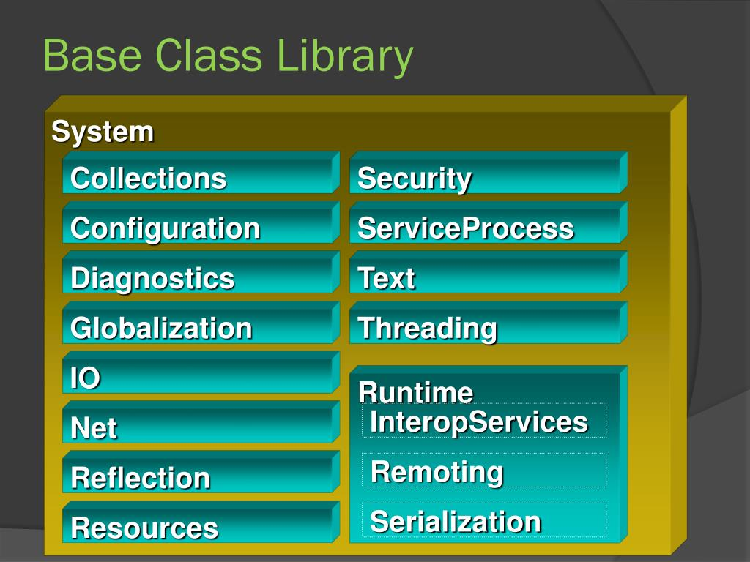
Base Class Library
The .NET Framework provides a vast base class library that developers can use to build a wide variety of applications, including desktop, web, mobile, and gaming applications.
The base class library is a collection of pre-built classes and libraries that provide common functionality such as input/output operations, networking, database access, security, and many others.

Slide 4
Namespace | brief description
System | contains the fundamentals for programming such as the data types, console and arrays etc
System.Data | is the namespace for ADO.NET
System.IO | provides connection to file system and the reading and writing to data streams such as files
System.Collection | contains lists, stacks, hash tables, dictionaries
System.Text | provides the stringbuilder class.
System.ServiceProcess | used when a window service is required
System.Security | provides hashing and the ability to create custom security system using policy and permissions

Slide 5
Thread Support
Thread Support :The CLR provides threat support for managing the parallel execution of multiple threads .
The System.Threading class is used as the base class for this.
The .NET Framework provides thread support for creating, managing, and synchronizing threads.
It also provides thread-safe collections and synchronization primitives to help developers build multithreaded applications.
It also provides synchronization primitives, such as Mutex, Locks to help developers synchronize access to shared resources.

Slide 6
Marshalling
Marshaling :-It is the process of creating bridge between managed code and unmanaged code.
Managed code : The code which is developed with in .NET framework
Unmanaged code:- The code which is developed outside .NET framework
When data is passed between managed and unmanaged code, it needs to be marshalled because managed and unmanaged code have different data representations and memory management models.
Marshalling ensures that the data is properly formatted and aligned for the target environment.

Slide 7
Type Checker
The .NET Framework provides a type checker to help developers detect and prevent type errors.
The type checker is responsible for verifying that all variables and parameters are of the correct type at compile time.
The primary goal of a type checker is to catch type-related errors at compile time, before the program is executed.
Type-related errors can include type mismatches, type conversion errors, and other type-related issues that can lead to bugs and unexpected behavior in the program.
A type checker can help improve the reliability and maintainability of software systems by detecting type-related errors early in the development process.

Slide 8
The exception manager is a component of the Common Language Runtime (CLR) that is responsible for managing the handling and propagation of exceptions that occur during the execution of a program.
When an exception is thrown, the exception manager is responsible for locating the appropriate exception handler and executing the code in that handler.
the security engine refers to the set of features and components that are responsible for enforcing security policies and protecting applications from unauthorized access or malicious activity.
the security engine helps developers build applications that are resilient to attacks and can be trusted to protect sensitive information.
Debug Engine :- It finds the bugs from the program, It works with the operating system to provide debugging services.
The debugger is responsible for providing support for debugging applications, such as breakpoints, step-through debugging, and watch windows.

Slide 9
Class Loader :-It is responsible for loading the class After checking the metadata.It performs resource checking, version checking and security checking.
The class loader is a key component of the .NET runtime environment, as it allows programs to load and execute classes on demand, rather than requiring all classes to be loaded into memory at once.
This can help reduce memory usage and improve performance, particularly for large programs or applications with many dependencies
The .NET Framework provides a garbage collector to help developers manage memory.
The garbage collector is responsible for tracking objects in memory and reclaiming memory from objects that are no longer in use.

Slide 10
JIT Compilers
the Just-In-Time (JIT) compiler is a component of the Common Language Runtime (CLR) that is responsible for converting compiled code, known as Intermediate Language (IL) code, into machine code that can be executed by the processor.
When a C# program is compiled, the resulting binary code is not in a format that can be executed directly by the processor.
Instead, the compiled code is in the form of IL code, which is a platform-independent instruction set that can be executed by the CLR.
When the program is run, the JIT compiler is responsible for translating the IL code into machine code that can be executed by the processor.

Slide 11
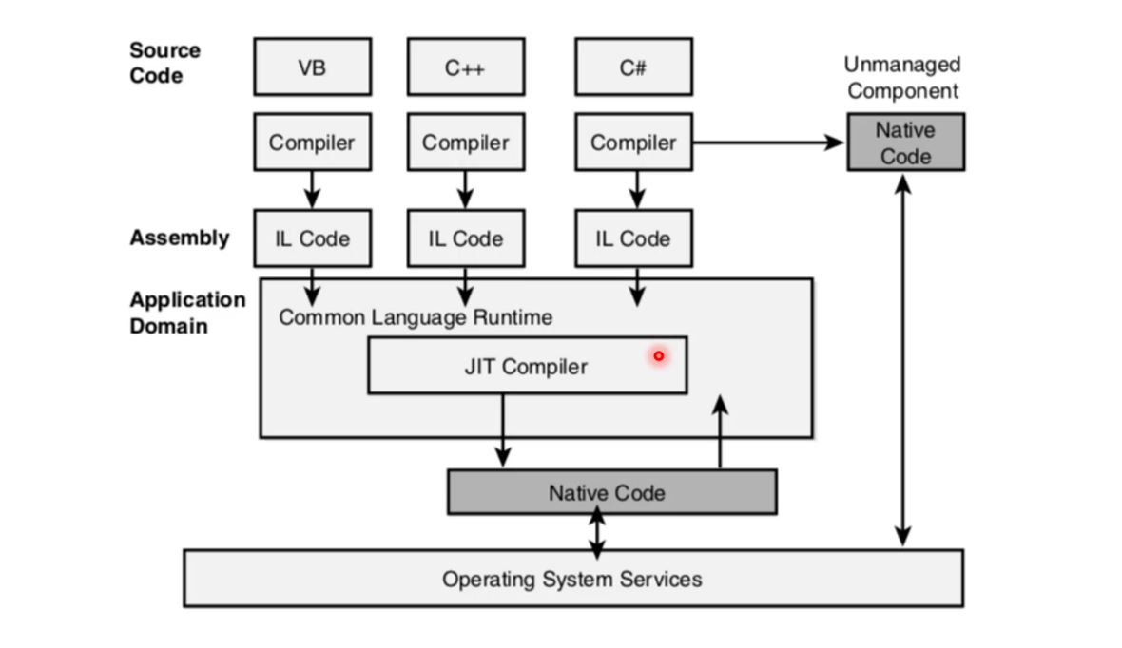

Slide 12
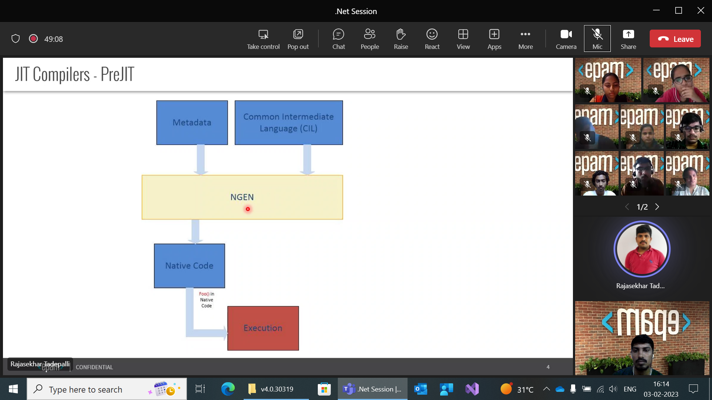
The first is the "pre-JIT" or "compile-time" JIT compiler, which is responsible for compiling all the IL code in an assembly into native machine code before the program is executed.

Slide 13
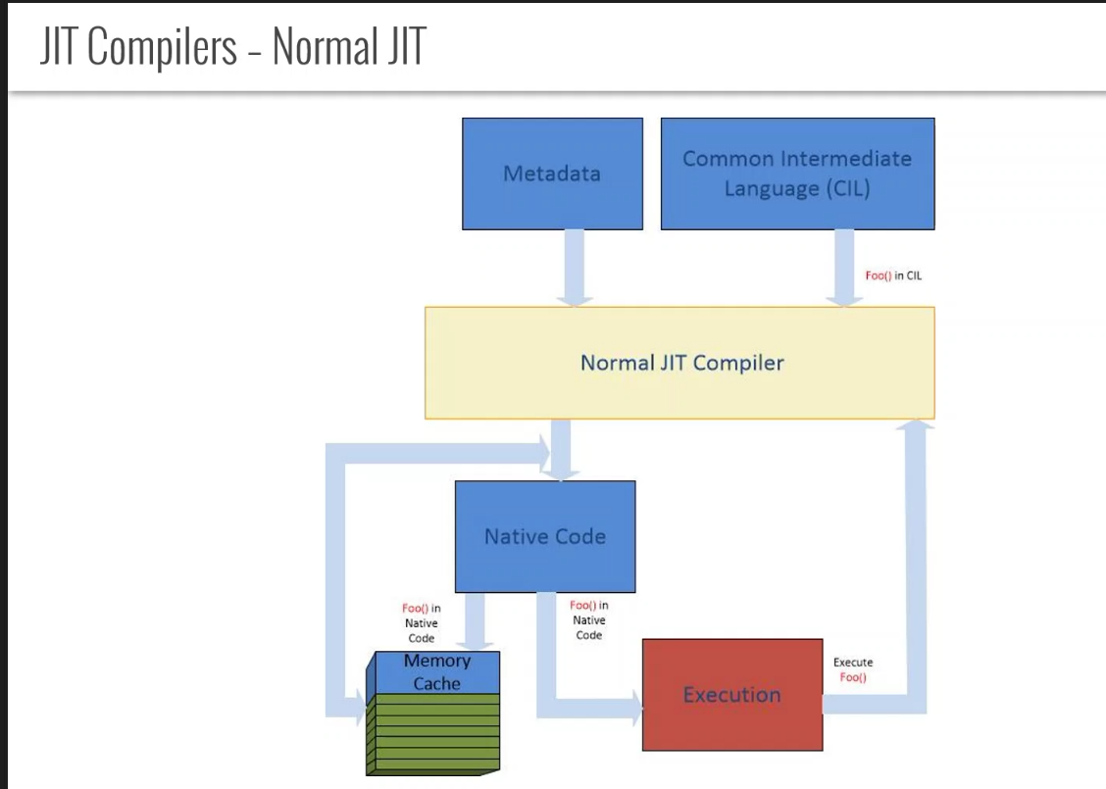

Slide 14
